Slide 1
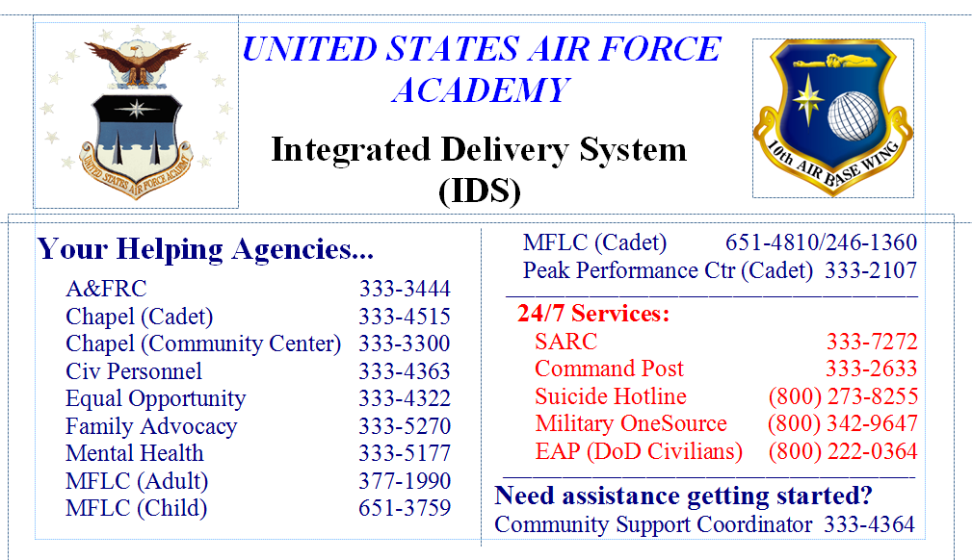
Do you need help?

Slide 2
Where are we now?
Review
Solving integrals
Tables
Simplifying with Substitution
Future Lessons
Solving by:
Integration by Parts
Rational Functions
Separable Equations
Switching Gears
Moving to applications of 2D area and 3D volume

Slide 3


Movie Clips

Slide 4
Math 152 – Lesson 8
Lesson | Topic | Reading
7 | Substitution Rule | 5.5
8 | Area Between Curves | 6.1
9 | Volumes | 6.2
Objectives:
Use integration to calculate the area between curves
Recognize when to define regions by regarding x as a function of y

Slide 5

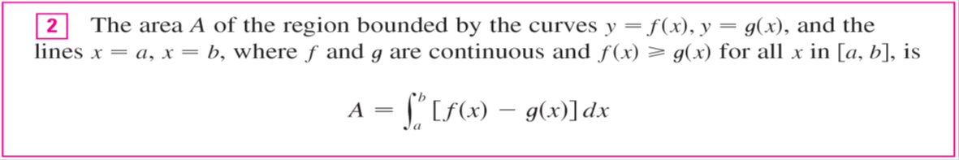
Areas Between Curves

Slide 6
Areas Between Curves

Slide 7
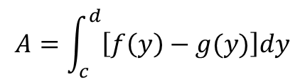
Areas Between Curves
$$A=\int_{c}^{d}{\left[f\left(y\right)−g(y)\right]dy}$$

Slide 8
Areas Between Curves
Break up into multiple areas
f (x) – g (x) when f (x) ≥ g (x)
| f (x) – g (x) | =
g (x) – f (x) when g (x) ≥ f (x)

Slide 9
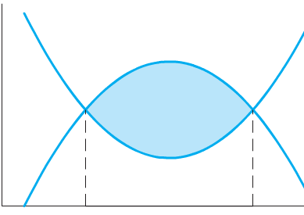
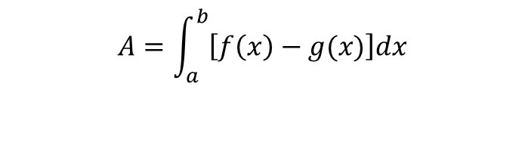
Board Work
Question: What is the area of the blue region?
f(x) = -x^2+4x-6
g(x) = x^2-4x
a
b
$$A=\int_{a}^{b}{\left[f\left(x\right)−g(x)\right]dx}$$
* Hint: You need to calculate limits of integration [a,b]

Slide 10
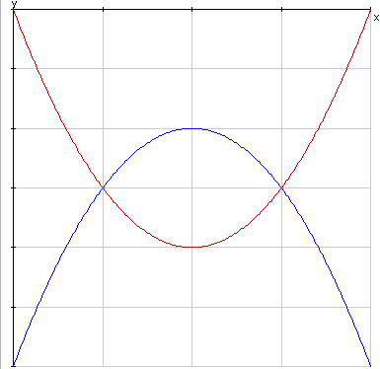
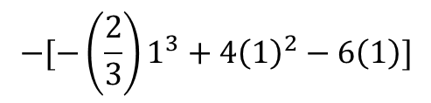
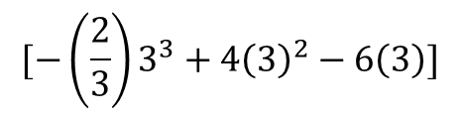
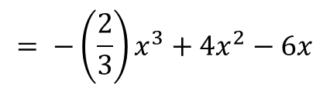
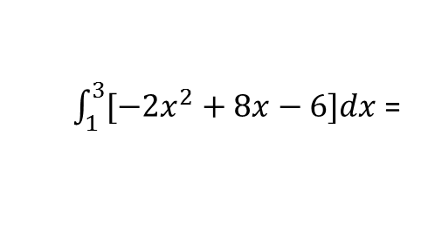
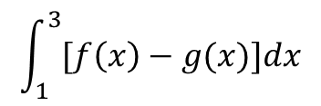
Board Work Solution
Solve for intersect points: g(x)=f(x) => x^2-4x+3 => (x-1)(x-3)
f(x)
$$\int_{1}^{3}{[f\left(x\right)−g(x})]dx$$
$\int_{1}^{3}{[−2x^{2}+8x−6}]dx$ =
g(x)
$$= −\left(\frac{2}{3}\right)x^{3}+4x^{2}−6x$$
$$[−\left(\frac{2}{3}\right)3^{3}+4{\left(3\right)}^{2}−6\left(3\right)]$$
$$−[−\left(\frac{2}{3}\right)1^{3}+4{\left(1\right)}^{2}−6\left(1\right)]$$
= (-18 + 36 - 18)-(-2/3 + 4 - 6) = 2.66
Notes:
You can WAG the area: 4*(1/2) = +2…UNDER estimate
Set f(x) = g(x) for the bounds of integration – 1 to 3
$\int{[g\left(x\right)−f(x)] dx}$ from 1 to 3
Example: if using Reimen sumation: g(2) – f(2) = -2 - -4 = +2

Slide 11
Board Work
Find the area of the region bounded by the curves y = sin x, y = cos x, x = 0, and x = π /2
Figure 10

Slide 12
Boar Work Solution
Solution:
The points of intersection occur when sin x = cos x, that is, when x = π /4 (since 0 ≤ x ≤ π /2). Observe that cos x ≥ sin x when 0 ≤ x ≤ π /4 but sin x ≥ cos x when π /4 ≤ x ≤ π /2.

Slide 13
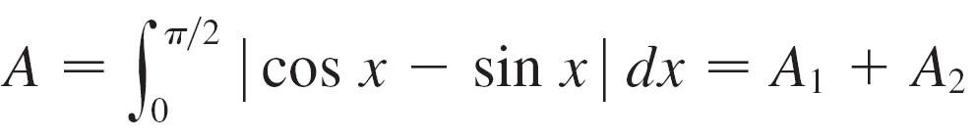
Board Work Solution
Therefore the required area is
Alternately: region is symmetric about x = π /4

Slide 14
Board Work
Find the area between $e^{x}$ and $cos(x)$ on the interval $[−1,1]$.
Find the are of the triangle with the given vertices:
(2, 0) , (0, 2), (-1, 1)

Slide 15
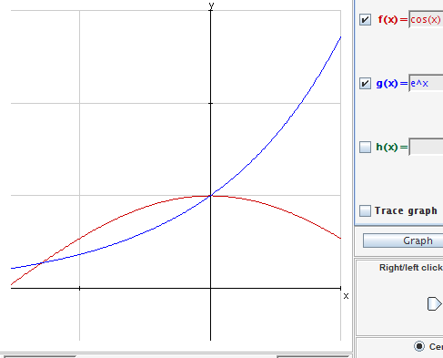

Board Work
Find the area between $e^{x}$ and $cos(x)$ on the interval $[−1,1]$.
Integrate [cos(x) – e^x] from -1 to 0, and then [e^x - cos(x)] from 0 to 1 =.209+.876=1.08616
Notes:
Integrate [cos(x) – e^x] from -1 to 0, and then [e^x - cos(x)] from 0 to 1 =.209+.876=1.08616

Slide 16
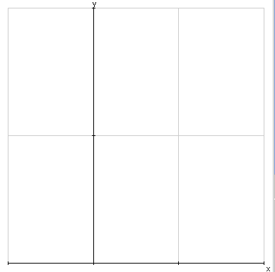
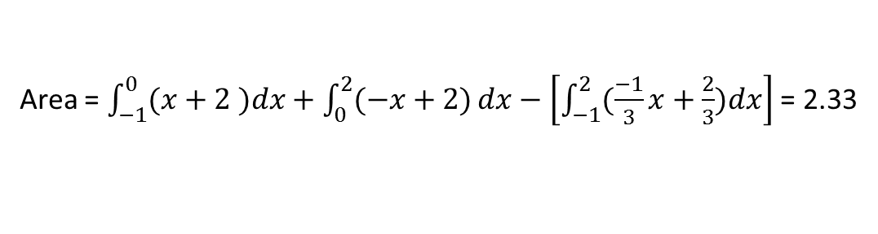
Board Work
Find the area of the triangle with the given vertices: (2, 0) , (0, 2), (-1, 1)
y = x + 2
y = -x + 2
y = -(1/3)x + 2/3
Area = $\int_{−1}^{0}{(x+2 )dx}+\int_{0}^{2}{(−x+2)}dx−\left[\int_{−1}^{2}{(\frac{−1}{3}x+\frac{2}{3})dx}\right]$ = 2.33
Notes:
Y = f’(a)( x – a) + f(a), f’(a) = m (ref p 251, tangent line approximation)
(0,2) to (2,0) m = (0-2)/(2-0) = -1 (0,2) y = -1(x-0) + 2
(2,0) to (-1,1) m = (1-0)/(-1-2) = -1/3 (2,0) y = (-1/3)(x-2) + 0
(-1,1) to (0,2) m = (2-1)/(0—1) = 1 (0,2) y = 1(x-0) + 2

Slide 18
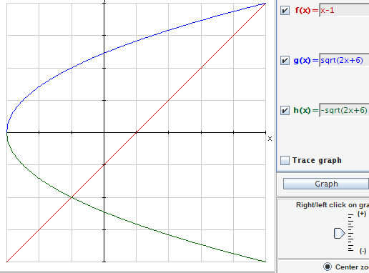
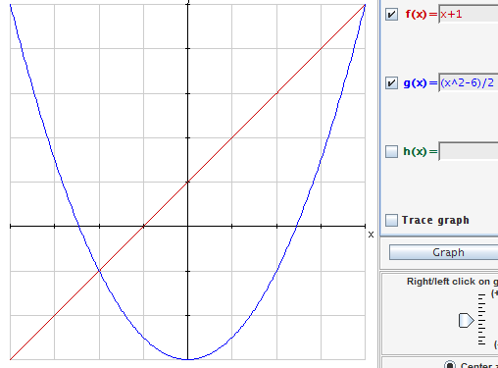

Board Work
Find the area between $y=x−1$ and $y^{2}=2x+6$.
Notes:
Integrate [(y+1) – (1/2)(y^2 - 6)] from y = -2 to y = 4
[-(1/2)y^2 + y + 4]
= [(-1/2)(y^3/3) + y^2/2 + 4y] evaluated from -2 to 4
(y+1) = (y^2-6)/2 (x+1) = (x^2-6)/2
y^2 – 2y – 8 = 0 x^2 – 2x – 8 = 0
(y – 4)(y + 2) = 0 (x – 4)(x + 2) = 0
y = -2, 4 x = -2, 4
(x-1)^2 = 2x+6 (y-1)^2 = 2y+6
x^2 - 4x - 5 = 0 y^2 – 4y - 5 = 0
(x – 5)(x + 1) = 0 (y – 5)(y + 1) = 0
x = -1, +5 y = -1, +5

